Slide 1
Show me, don’t tell me: Sprint 5 Demo
30 November 2021

Slide 2
Sprint 5 Approval (1 of 3)
CLIN 0001AB
Sprint Dates: 11/17/2021-11/30/2021
Sprint Goals: Pushed Health Apartment POC Design homepage to mid fidelity. Created communication asset, POC Design PPT, and aligned stakeholders. Updated POC Design Site Map and
iterated low fidelity Health Apartment POC Design homepage into mid fidelity incorporating IA tree test synthesized feedback. Captured MyVA overlap with Health Apartment POC Design homepage in POC Design PPT.
Priority | Epic: User Story | Acceptance Criteria
High | POC Design: Synthesize IA tree test and infuse learnings into Site Map, POC Design PPT, and concepts to address user feedback in Health Apartment POC Design homepage | Synthesized IA tree test and captured insights, opportunities, and potential solutions to address IA tree test user feedback in both POC Design PPT and Site Map Mural Socialized and discussed IA tree test insights, opportunities, and potential solutions to address user feedback using POC Design PPT, Site Map Mural, and Health Apartment POC Design to guide discussion with VA PO and VA Design Lead prior to Sprint 5 demo Captured feedback and requested changes to Health Apartment POC Design, POC Design PPT, and Site Map Mural in the POC Design PPT (requested changes to be considered in future sprints) Demonstrated work to VA Executive Sponsor in Sprint 5 demo Deliverable: Developed POC Design PPT and captured learnings, impacts, and recommendations Deliverable: Updated Site Map Mural (v4)
High | POC Design: Iterate Health Apartment POC Design homepage wireframes from low to mid level of fidelity for both authenticated and unauthenticated user experiences | Iterated Health Apartment POC Design unauthenticated and authenticated homepage wireframes from low fidelity (output of previous sprint) to mid fidelity using Sketch for both mobile and desktop versions Iterated Health Apartment POC Design unauthenticated and authenticated homepage wireframes for both mobile and desktop versions based on user feedback from IA tree test If required, created 1+ Health Apartment POC Design unauthenticated and authenticated homepage concepts to address IA tree test feedback to be used in future user testing Identified and documented user feedback, impact on components and features on Health Apartment POC Design homepage, and concepts / potential solutions to address feedback in POC Design PPT Socialized and discussed work with VA PO and VA Design Lead prior to Sprint 5 demo Captured feedback and requested changes to be considered in future sprints Demonstrated work to VA Executive Sponsor in Sprint 5 demo Deliverable: Captured learnings, impacts/changes, concepts to address user feedback, and recommended next steps in POC Design PPT Deliverable: Iterated Health Apartment POC Design homepage wireframes including updates based on IA tree test

Slide 3
Sprint 5 Approval (2 of 3)
CLIN 0001AB
Priority | Epic: User Story | Acceptance Criteria
High | POC Design: Review MyVA and prepare for future OCTO engagement with MyVA team | Conducted deep dive into MyVA dashboard value proposition (e.g., key features and benefits) Identified and documented impacts and overlaps of Health Apartment POC Design and MyVA product (e.g., notifications) in POC Design PPT Defined objectives, questions and created activities to guide future discussion with MyVA team Socialized and discussed objectives, questions and activities with VA PO and VA Design Lead prior to Sprint 5 demo Captured feedback and requested changes to be considered in future sprints Demonstrated work to VA Executive Sponsor in Sprint 5 demo Deliverable: Captured learnings and impacts in POC Design PPT
High | POC Design: Synthesize navigation system research and identify additional impacts on Health Apartment POC Design | Synthesized research into navigation system and uncovered insights, design opportunities, and impacts on Health Apartment POC Design (e.g., homepage and landing pages for auth and not auth key features) Identified and documented impacts on Health Apartment POC Design homepage in POC Design PPT Identified and documented considerations on Health Apartment POC Design to be used during design of Health Apartment POC Design key features in future sprints in POC Design PPT Socialized and discussed considerations on Health Apartment POC Design to be used during design of Health Apartment POC Design key features in future sprints using POC Design PPT with VA PO and VA Design Lead prior to Sprint 5 demo Captured feedback and requested changes to be considered in future sprints Demonstrated work to VA Executive Sponsor in Sprint 5 demo Deliverable: Captured learnings and impacts in POC Design PPT including impacts on homepage and considerations for Health Apartment POC Design features to be designed in future sprints
Med | POC Design: Define and align on clear acceptance criteria for Health Apartment POC Design and capture in POC Design PPT | Created agenda, materials, and activities to conduct workshop to align on clear acceptance criteria for Health Apartment POC Design Conducted workshop with Executive Sponsor, VA PO, and VA Design Lead to align on clear acceptance criteria for Health Apartment POC Design and prioritized and sequenced plan to deliver Health Apartment POC Design feature (i.e., Health Apartment POC Design wireframe creation order) Captured written approval for Health Apartment POC Design from VA PO in email Reviewed Product Roadmap and incorporated changes based on refined acceptance criteria for Health Apartment POC Design Socialized and discussed Product Roadmap with VA PO and VA Design Lead prior to Sprint 5 demo Captured feedback and requested changes to be considered in future sprints Demonstrated Product Roadmap with VA Executive Sponsor during Sprint 5 demo Deliverable: Updates to POC Design PPT

Slide 4
Sprint 5 Approval (3 of 3)
CLIN 0001AB
Priority | Epic: User Story | Acceptance Criteria
Low | POC Design: Infuse approach to developing Health Apartment POC Design with VA.gov user research / testing processes, methods, and tools | Reviewed VA.gov user research processes, methods, and tools Incorporated VA.gov user research processes, methods, and tools into POC Design PPT (i.e., used these processes, methods, and tools to capture feedback and changes to Health Apartment POC Design homepage) Created user stories in Product Roadmap to incorporate VA.gov user research processes, methods, and tools into workflow in future sprints (e.g., GitHub README, research findings deck, etc.) Socialized and discussed incorporation of VA.gov user research / testing processes, methods, and tools with VA PO and VA Design Lead prior to Sprint 5 demo Captured feedback and requested changes to be considered in future sprints Demonstrate incorporation of VA.gov user research / testing processes, methods, and tools to VA Executive Sponsor in Sprint 5 demo Deliverable: Captured learnings and impacts in POC Design PPT and incorporated VA.gov user research / testing processes, methods, and tool into POC Design PPT and Product Roadmap
Low | Collaboration Cycle: Prepare for "2-Discover" Step in Collaboration Cycle | Scheduled and conducted meeting with Ryan Thurlwell to prepare for and maximize value for Health Apartment POC Design through Collaboration Cycle Captured insights and next steps in POC Design PPT Socialized and discussed learnings with VA PO and VA Design Lead prior to Sprint 5 demo Captured feedback and requested changes to be considered in future sprints Demonstrated work to VA Executive Sponsor in Sprint 5 demo *Deliverable: Updates to POC Design PPT
*User story may not be completely accomplished due to dependencies / order and potential lack of availability of key government stakeholders. Risks will be raised as early as possible and updates will be shared in a timely manner.

Slide 5
POC Design: Synthesize IA tree test results
CLIN 0001AB
Deliverable:
Developed POC Design PPT and captured learnings, impacts, and recommendations
Updated Site Map Mural (v4)
Summary of insights
Users are task-oriented but most seek information before doing a task.
The most frequently sorted "Health" cards* were separated in the IA, causing confusion and ambiguity across the top-level sections.
"Help and resources" is not helpful unless users know what specific information it offers.
The deeper the nesting, higher the failure rate.
User experience (UX) and information architecture (IA) are independent of one another and need to be handled separately.
Attempts to show everything at once is actually causing cognitive fatigue.
Recommendations
Less is more; economize and package content
Limit number of layers and keep themed buckets
Keep information accessible at action points
Provide clarity by avoiding sound-alike, look-alike, or dual meaning captions
See more incorporated in wireframes
Notes:
paula 5-7

Slide 6
POC Design: Homepage wireframe concepts to mid fidelity
CLIN 0001AB
Deliverable:
Captured learnings, impacts/changes, concepts to address user feedback, and recommended next steps in POC Design PPT (slide 32+)
Iterated Health Apartment POC Design homepage wireframes including updates based on IA tree test (link here)
Captured Learnings
Focus on making unauthenticated content informational
Organizing informational content to make it easily distinguishable from tasks
Need to make sure things fit in design system and are technically feasible
Important to distinguish between VA Health Care, Community Care, and My VA (IA concept 3)
VA is unique in having a lot of self entered health data living alongside data from labs, hospitals, etc. This can confuse users because it is unusual/unexpected when compared to other health care services
Further testing
Validation of bucket clusters for ease of locating for user
How to maximize value of resource section v. paired access to information-to-action concept
Should Health Supplies be accessible from within Health Care section and Pharmacy (think drug delivery device v. colostomy bag)
Should clear division exist between patient entered data and provider entered data (think home point-of-care testing v. laboratory testing)
Experiment with word choice (Health v. medical; benefit v. coverage)

Slide 7
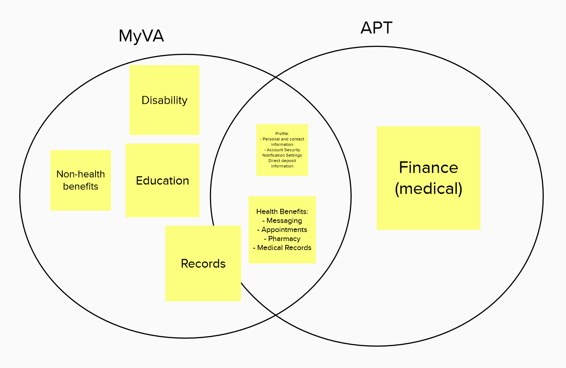
POC Design: Review MyVA.gov and prep for OCTO
CLIN 0001AB
Deliverable: Captured learnings and impacts in POC Design PPT
Documented current and potential overlaps between MyVA and the apartment concept, including health care benefits, “profile,” and “records.”
Captured areas of opportunity for design alignment and consistency in MyVA dashboard
Suggested next steps for closer collaboration with MyVA

Slide 8
POC Design: Review MyVA.gov and prep for OCTO
CLIN 0001AB
Questions:
Where is MyVA in the redesign process?
Will APT direct to same appointment scheduler as MyVA?
Will APT Messaging direct to/use same MHV tool as MyVA?
Will MyVA and APT eventually merge?

Slide 9
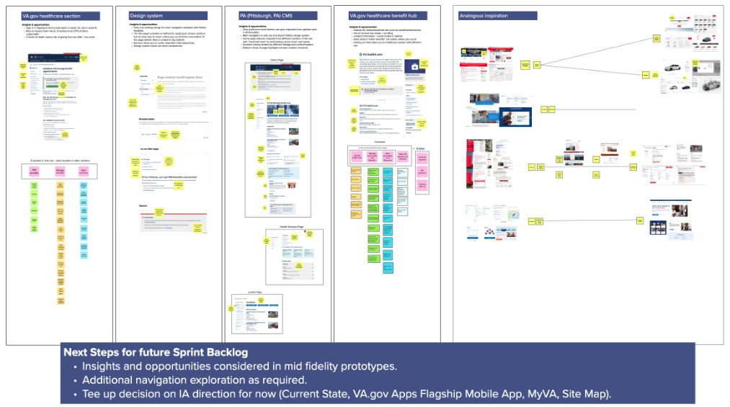
POC Design: Synthesize navigation system research
CLIN 0001AB
Deliverable: Captured learnings / impacts in POC Design PPT including impacts on homepage and considerations for Health Apartment POC Design features to be designed in future sprints
Synthesized research into navigation system and uncovered insights, design opportunities, and impacts on Health Apartment POC Design (e.g., homepage and landing pages for auth and not auth key features)
Please refer to IA Design chapter in PPT

Slide 10
POC Design: Define VFS-APT POC acceptance criteria
CLIN 0001AB
Deliverable: Updates to POC Design PPT
Reviewed and synthesized various research reports and conversations notes to consolidate priorities, effort levels, and capabilities
Developed proposed POC features for feedback / alignment
Conducted meeting with Ryan Thurwell per Lauren’s guidance
Proposed POC features:
Homepage
Appointments (scheduling)
Messaging

Slide 11
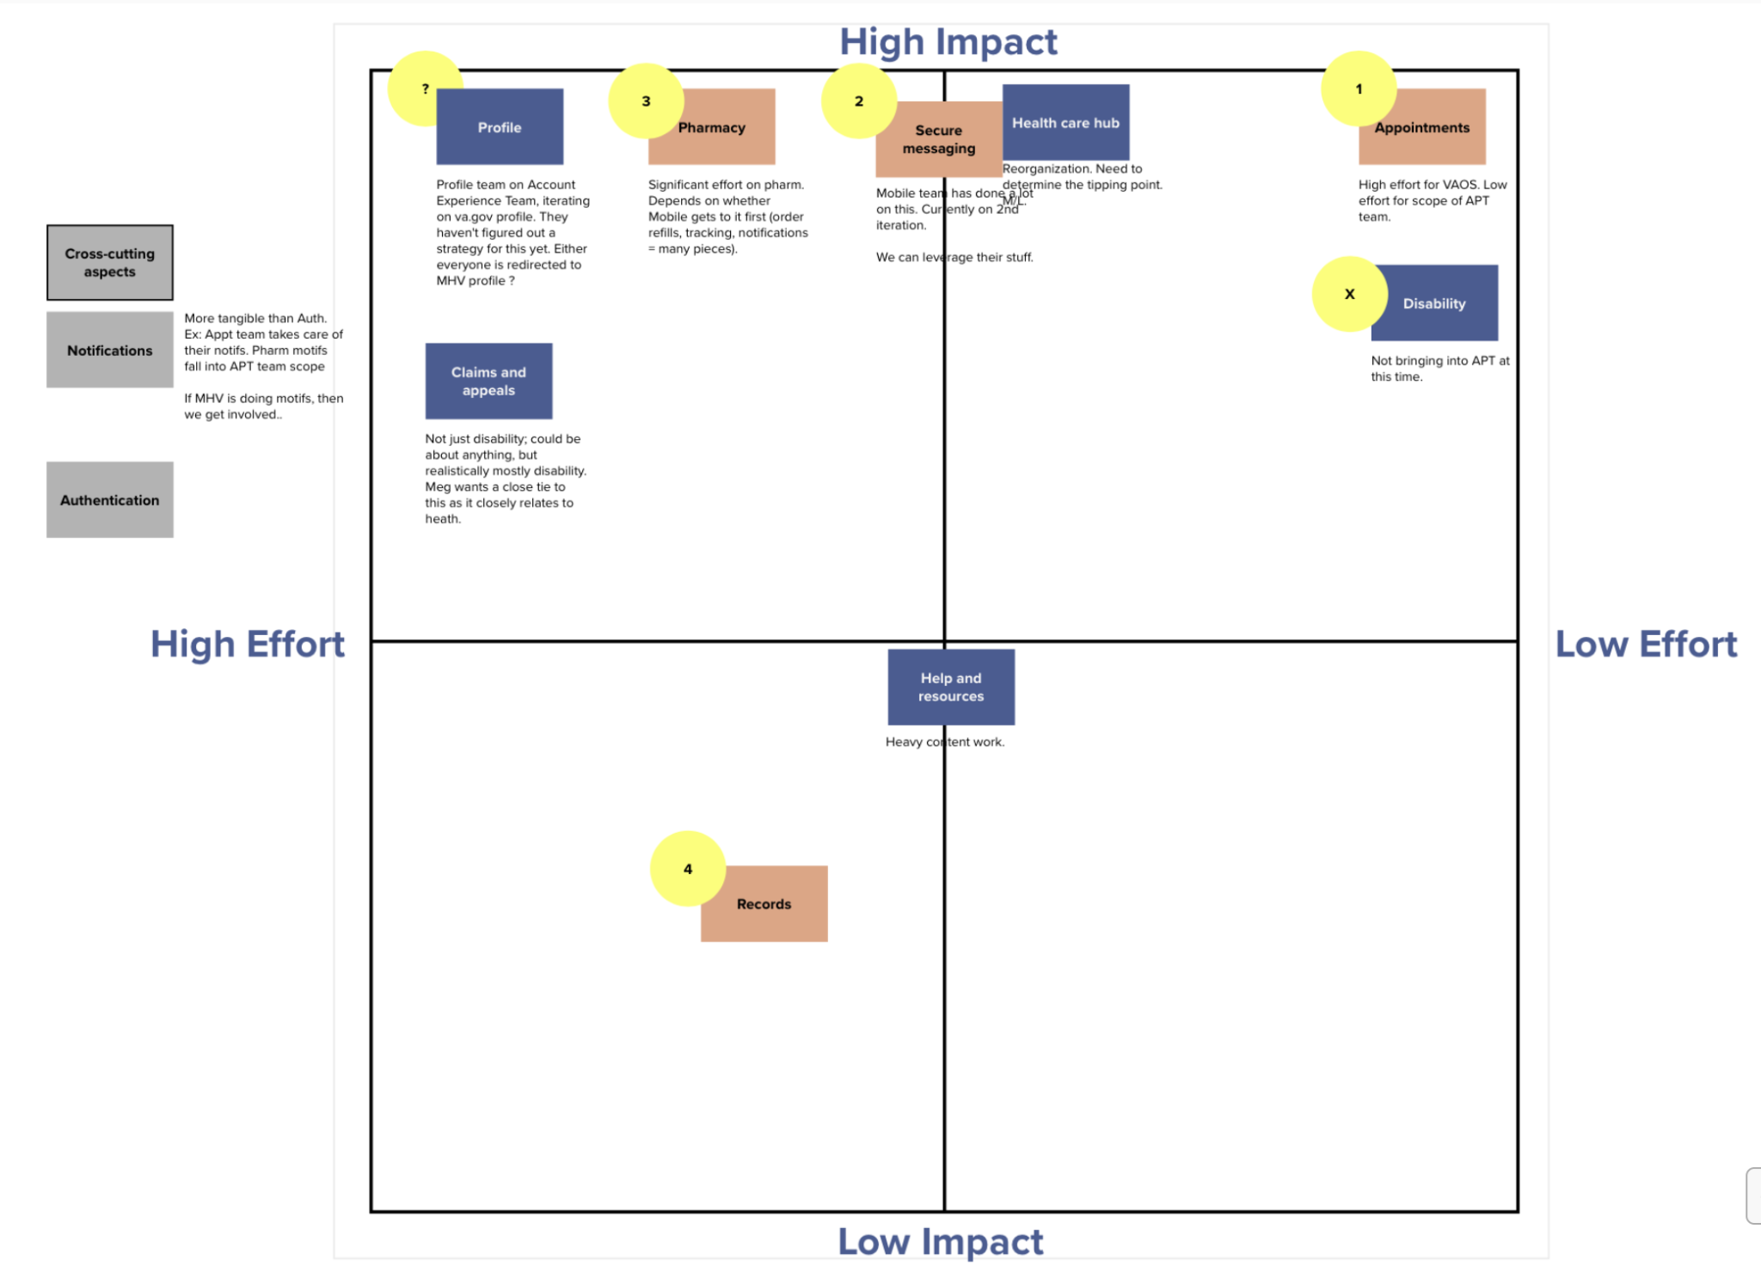
POC Design: Define VFS-APT POC acceptance criteria
CLIN 0001AB
Next Steps
Finalize POC feature acceptance with VA PO, Design Lead and Executive Sponsor
Remaining questions
Where and when is the handoff between Apartment and VAOS?
What is our direction on navigation?

Slide 12
POC Design: VA.gov exploration
CLIN 0001AB
Deliverable:
Captured learnings and impacts in POC Design PPT
Incorporated VA.gov user research / testing processes, methods, and tool into POC Design PPT and Product Roadmap
* Please refer to IA Tree Test research methodology in PPT and applied learnings

Slide 13
Collaboration Cycle: Design intent
CLIN 0001AB
Deliverable: Updates to POC design PPT
Scheduled and conducted meeting with Ryan Thurlwell 11/29
Reviewed work to date with positive comments on mid fidelity wireframes for auth / unauth home pages
Insights
Landscape of My VA , Mobile, and notification functions remain undetermined and final decisions could affect homepage design content decisions
Emphasized that we focus on deeper levels then return to homepage when higher level collaborative decisions are finalized
Test design schemes using adaptability settings (specifically 400% zoom and how items should shake out)
Use economy of word choice to save space
Think through notification scheme (all v. focus for content page)
Next steps
Continue with Sprint 6 plan to test iterate, retest current homepage designs to settle into preferred design plan for MVP
Evaluate current and developing wireframe designs for cursory adaptability
Brainstorm notification needs for work product.
Convene meeting with Ryan Thurlwell (USDS DEPO design Lead), VA-PO, product owner, and development team to discuss current product and collaboration timeline with other teams.

Slide 14
End of Sprint 5 Update
CLIN 0001AB
The team’s accomplishments this sprint include:
IA Tree Test synthesis
Synthesized IA tree test results; identified HMW opportunities for design 11/18
Shared mural with design team 11/18 for inclusion in potential concepts 11/19
Tightened IA on sitemap 11/22
Homepage wireframe concepts to mid fidelity
Secured access and training on Sketch for development team 11/17
Developed multiple low-fi prototype concepts for consideration 11/18
Aligned and selected top 3 prototype design concepts to develop to mid-fi 11/19
Developed mid-fi wireframes for concept 1 11/22
Developed mid-fi wireframe and navigation considerations concept 2 11/23
Evolved mid-fi wireframes concept A w/ navigation, and developed concept 3 with navigation considerations 11/24
Completed mid-fi wireframes for concept 3 and completed PPT 11/29
MyVA.gov research and OCTO engagement prep
Initiated research into MyVA 11/24
Synthesized research (impacts / overlaps) 11/29
Navigation research synthesis
Conducted navigation review of MHV and included in conceptual wireframes 11/22
Conducted deepdive into previous user tests and concepts for earliest work on MHV for potential insights / inclusion with current POC 11/24
Finalized research report into mural and PPT items 11/29
Health Apartment POC Acceptance Criteria
Conducted meeting with VA PO to discuss wavetops of POC Acceptance criteria 11/23
Reviewed and synthesized various research reports and conversations notes to consolidate priorities, effort levels, and capabilities 11/26
Developed proposed POC features for feedback / alignment 11/29
Conducted meeting with Ryan Thurwell per Lauren’s guidance 11/29
VA.gov exploration
Implemented VA.gov research methodology and result synthesis into IA tree test 11/23
Collaboration cycle, design intent
Researched collaboration cycle requirements 11/18
Conducted meeting with Shira from VA Platform Support (collab kickoff delayed for MVP)
Researched checkpoint criteria and created phased checklist x 2 11/19
Messaged Ryan Thurlwell 11/22; OOO for holiday rtn 11/29
Created additional checkpoint criteria checklist x1 11/23
Conducted introductory meeting with Ryan Thurlwell and captured insights and next steps for consideration in future sprints 11/29

Slide 15
Sprint 5 Acceptance
CLIN 0001AB
Sprint Dates: 11/17/2021-11/30/2021
Sprint Goals: Make progress toward Health Apartment POC through evolving sitemap and initial mid fidelity homepage concepts with navigation implications and design consideration from IA tree test, VA.gov / MyVA.gov research. Consolidate research and questions for MyVA.gov OCTO engagement. Align on VA product checkpoint / tollgate expectations and health apartment POC acceptance criteria.
Focused Epics (Approval)
POC Design: IA Tree Test synthesis
POC Design: Homepage wireframe concepts to mid fidelity
POC Design: MyVA.gov research and OCTO engagement prep
POC Design: Navigation research synthesis
POC Design: Health Apartment POC acceptance Criteria
POC Design: VA.gov exploration
Collaboration cycle: Design intent
Focused Epics (Acceptance)
√ POC Design: IA Tree Test synthesis
√ POC Design: Homepage wireframe concepts to mid fidelity
√ POC Design: MyVA.gov research and OCTO engagement prep
√ POC Design: Navigation research synthesis
√ POC Design: Health Apartment POC acceptance Criteria
√ POC Design: VA.gov exploration and integration options
√ Collaboration Cycle: Design intent Stakeholder engagement: USDS Design Lead
Deliverables: Name / Description | Acceptance Criteria
POC Design PPT | √ Synthesized, captured, annotated IA tree test results and impacts on components / features for wireframe development √ Identified impacts and overlaps of MyVA product on POC design √ Defined objectives, questions, and activities to guide future interaction with myVA team √ Captured VA.gov research, process, methods, tools, and feedback / changes for POC design √ Synthesized navigation system research with insights, design opportunities, and impacts on POC design features √ Captured design insights and next steps Ryan Thurlwell USDS DEPO Design Lead
Homepage concepts (mid-fidelity) Sketch | √ User feedback from IA tree test incorporated into 3 Sketch homepage wireframe concepts (auth/non-auth, mobile/desktop) √ Annotated in mural impacts on components / features for deeper level wireframes for consideration in future sprints √ Synthesized navigation system research into mid level fidelity wireframes; identifying breaks √ Identified navigation points where system will be broken
Evolved sitemap mural | √ Updated sitemap (v4) to include insights from IA tree test synthesis
VA-PO engagement | √ Invited VA-PO & VA design lead to 3 design discussions per sprint √ Invited VA-PO to PM synch twice a week √ Captured feedback and requested changes for design consideration in current and future sprints √ Defined & confirmed acceptance criteria for health apartment POC design and incorporated into roadmap

